Slide 1
At-Home full care overbed table
By: Agam Aneja, Udai Kahlon, Baldeep Dhillon and Gurkirat Sital

Slide 2
Huntington’s Disease
Hereditary
Occurs when a faulty gene causes buildup of toxic proteins in the brain.
Although it is not uncommon to develop this disease in the early ages, it usually develops between middle ages of 30-45.
Mostly occurs to people with European ancestry.
Incurable
Referenced from (1) and (2)

Slide 3
Huntington’s Disease
What are the symptoms?
Most symptoms begin with depression
Leads to other behavioural disturbances as anxiety, irritability, moodiness, etc.
Once the brain is affected, the effects get more severe leading to speech difficulties.
Physical symptoms include, but are not limited to, trouble with balancing, severe weight loss, unsteady gait and inability to walk.
Referenced from (1) and (2)

Slide 4
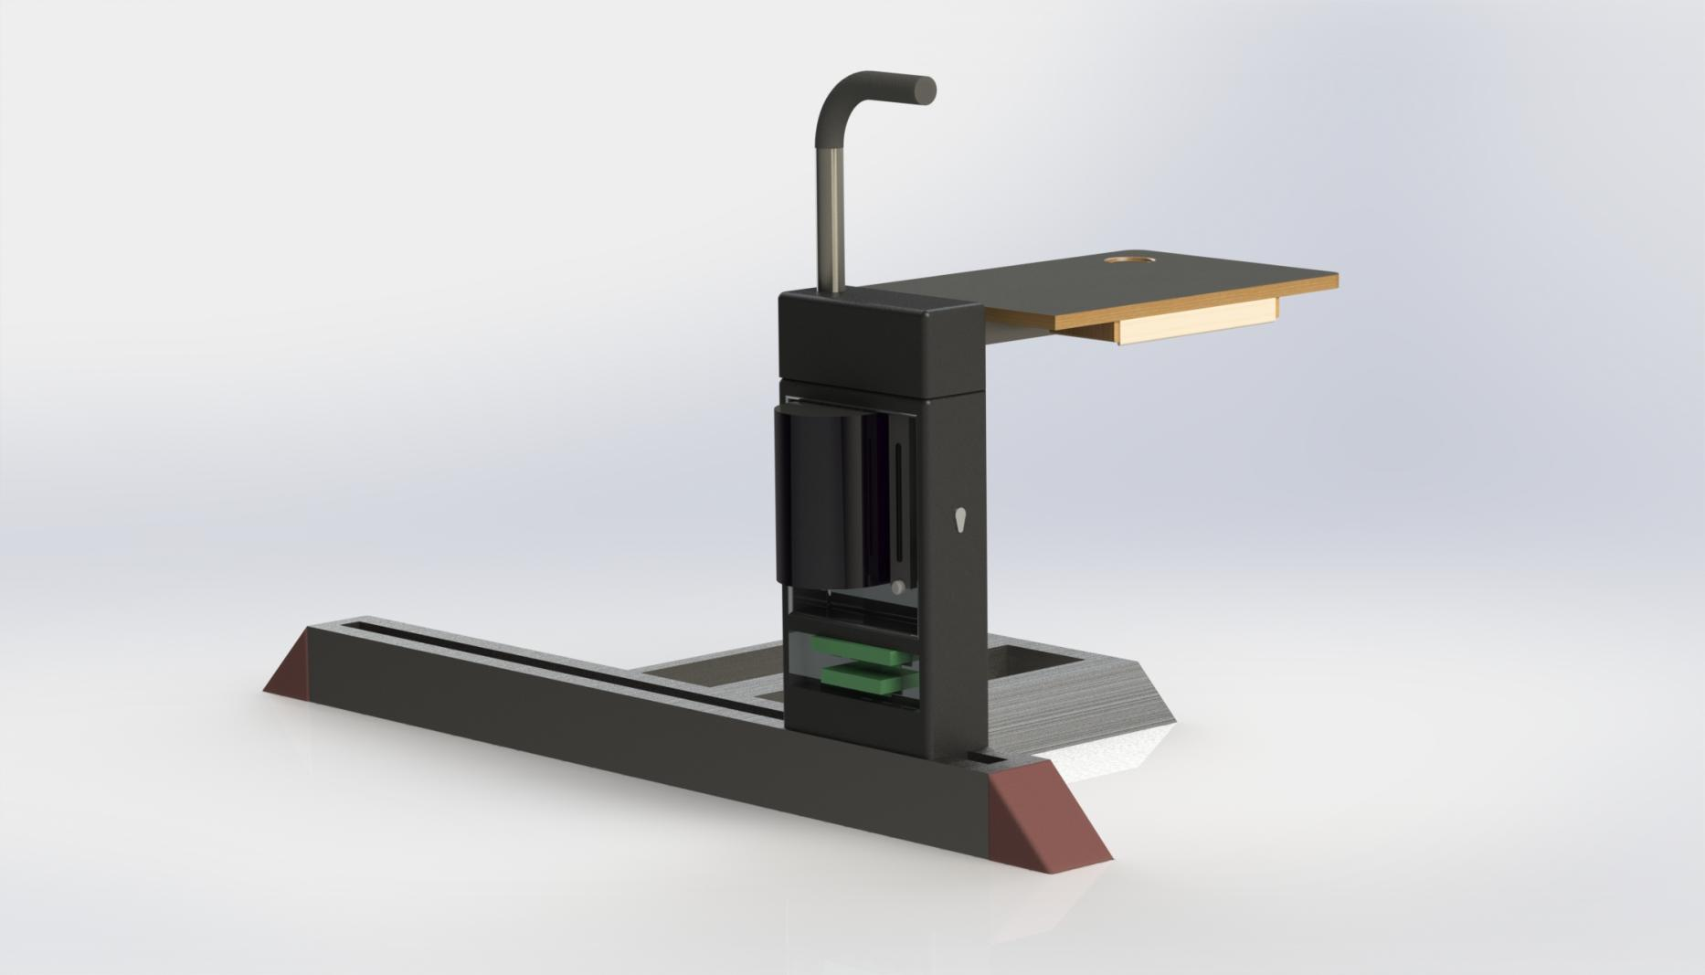
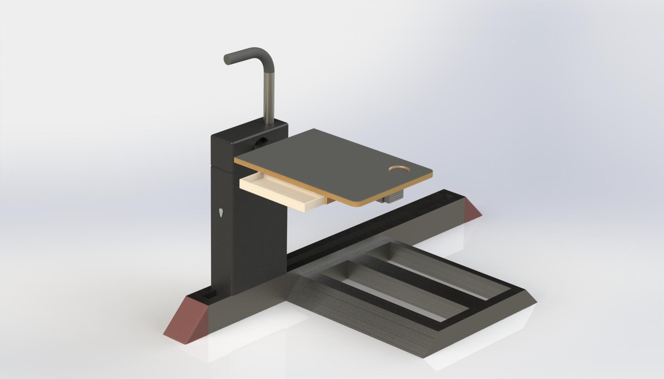
Our Solution

Slide 5
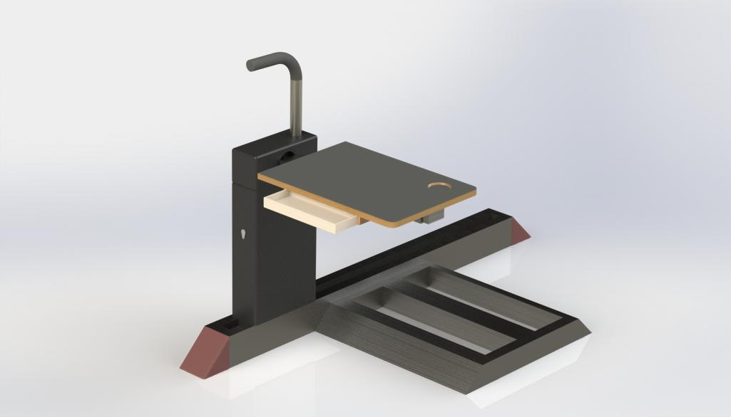
Why this helps?
Being incurable, it is important for the patients to learn how to live with it till this disease causes inevitable death in 10-20 years.
Bedridden so we designed an overbed table that can assist the patients with activities of their daily living such as eating, a cup holder for placing drinks/water, an extending grip bar that provide support when the patient desired to get off the bed.
Other features include a pill dispenser towards the bottom which is harder for the patient to directly to prevent overdose, a wet tissue and dry soap dispenser which can be switched out for anything the patient desires.
Notes:
All these provide the patient with an easier access to things which they would normally have to either trouble themselves with or have a caretaker do for them.

Slide 6
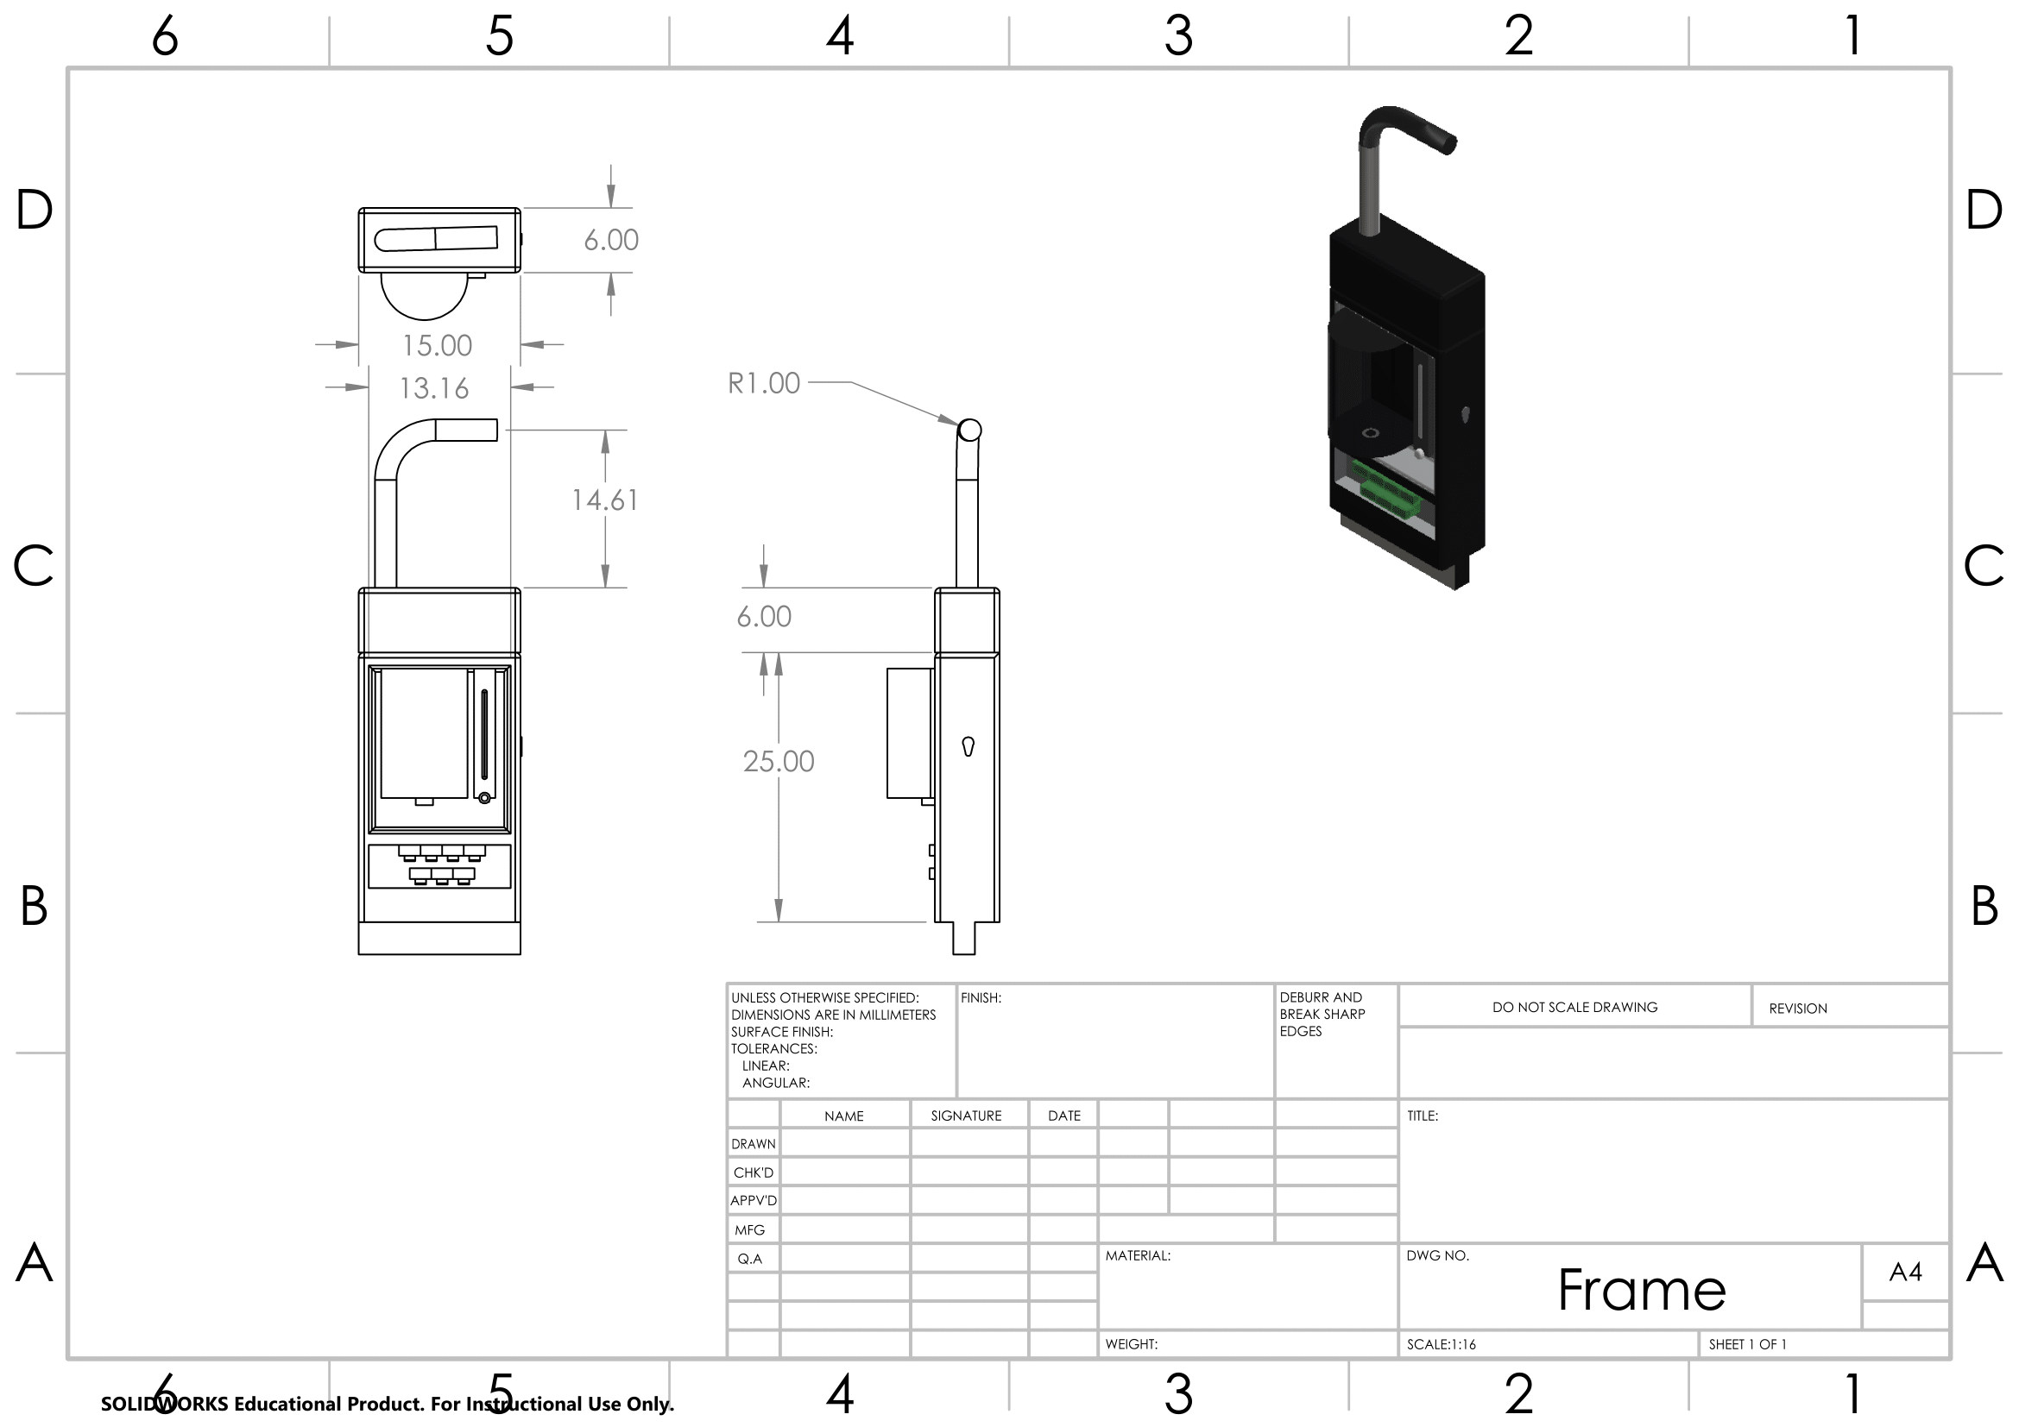

Slide 7
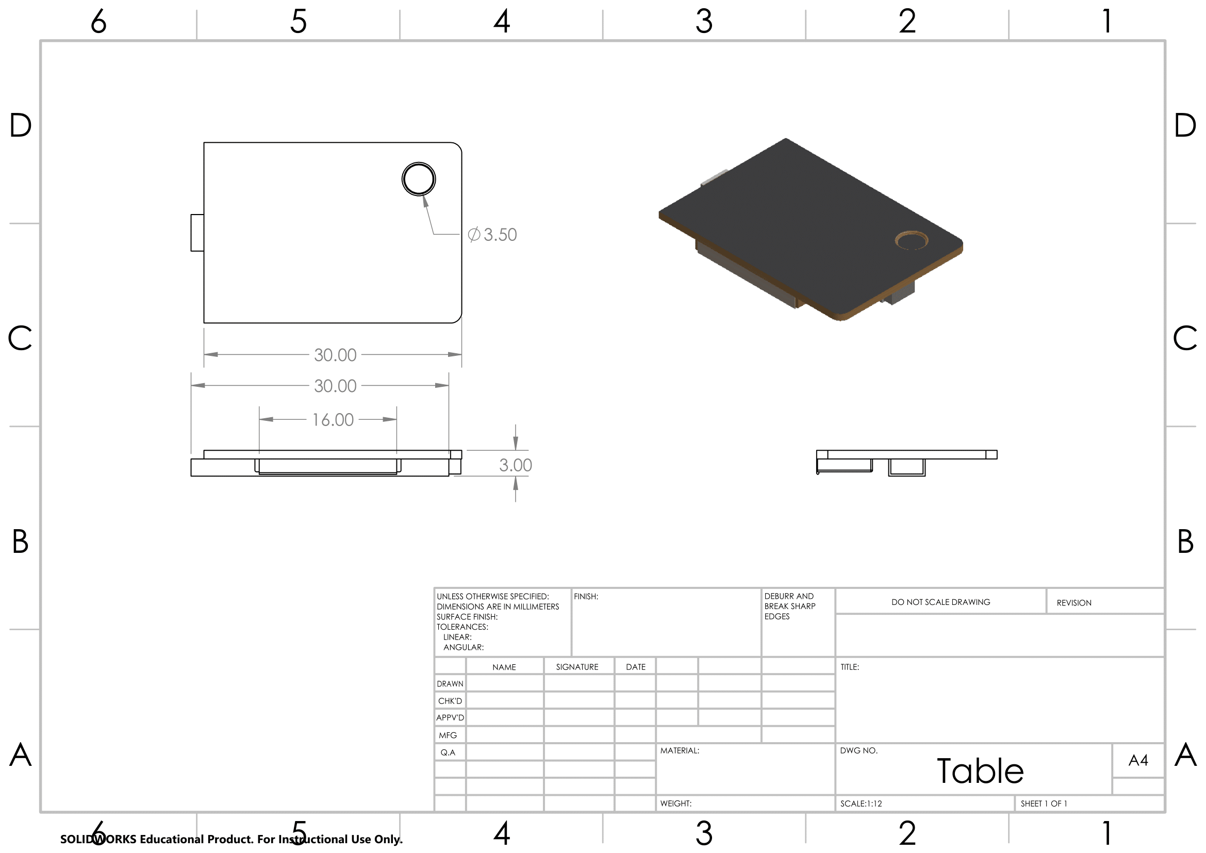

Slide 8
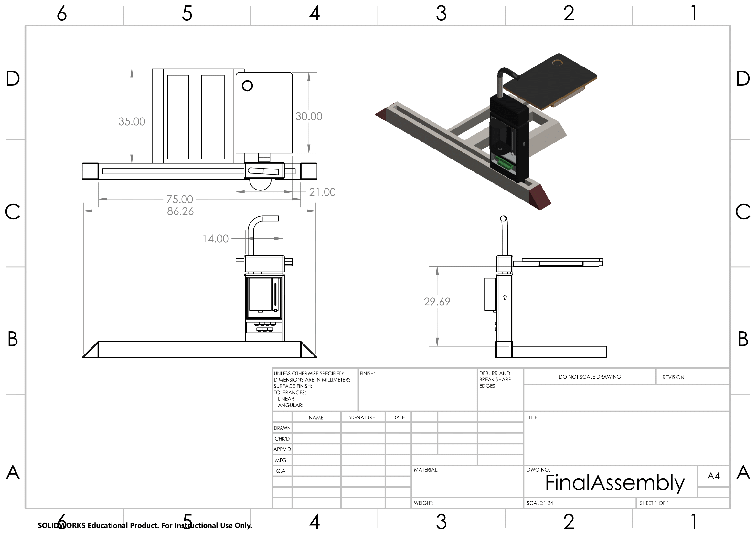

Slide 9
Material Selection and the estimated costs for production
Material selection for this product was crucial for safety and affordability of the user.
The prototype’s shell along with the pill dispensers and other containers are made of plastic.
Interior mechanisms within the shell are made from steel to provide stability and a longer shelf life.
The desk itself is made from oak wood with rounded corners to prevent any injuries from sharp corners and a strong base.
The desk is covered with rubber along with the cup holder to prevent spillage by increasing friction.
With all the materials involved along with the possibility of attaching this table to any sized bed, the production costs line up to be in the range of $250-$350.

Slide 10
References
Braizer, Y. (2019, November). Huntington's disease: Symptoms, causes, and treatment. Retrieved January 10, 2021, from https://www.medicalnewstoday.com/articles/159552
Huntington disease. (2015, July 07). Retrieved January 10, 2021, from https://rarediseases.info.nih.gov/diseases/6677/huntington-disease

Slide 11
Thank you for listening.

